Slide 1




Kimia Farma Business Performance 2020 - 2023
Kimia Farma - Big Data Analytics
Presented By: Debby Rofiko Malik

Slide 2




Debby Rofiko Malik
Data Enthusiast
A highly adaptable Biomedical Engineering graduate from Universitas Indonesia with strong analytical skills and solid problem-solving abilities. Experienced in turning raw data into clear, actionable insights using Excel, SQL, and Looker Studio. A fast learner with a firm belief in the value of data for informed decision-making and sustainable growth, committed to continuous learning and delivering effective data-driven solutions.
West Jakarta
debbymalik21@gmail.com
Debby Rofiko Malik

Slide 3


Courses & Certifications
Data Science & Data Analysis
| Link Certificate
(October, 2025)
Machine Learning with Python
| Link Certificate
(June, 2024)

Slide 4


About the Company
Kimia Farma Tbk is Indonesia’s first pharmaceutical company, founded in 1817 and now part of the state-owned enterprise (BUMN) group. The company operates in pharmaceutical manufacturing, distribution, and retail services. With an extensive network of pharmacies and branches across the country, Kimia Farma plays a significant role in providing the public with accessible, high-quality, and affordable healthcare products.

Slide 5






Final Project Summary
The final assignment of the internship required an in-depth examination of actual transactional data from 2020 to 2023. This thorough analysis aimed to uncover essential insights that would aid in making more informed and strategic business choices. The focus was on evaluating revenue trends over the years, identifying the best-performing branches, highlighting discrepancies between branch performance and customer ratings, and analyzing the distribution of profits across different provinces.
Problem Statement
Repo &
Walk-
through
Outcome
Highlight
How can Kimia Farma leverage transactional data from 2020–2023 to evaluate branch performance, understand profit distribution across regions, and uncover product and customer insights that inform more effective business strategies?
The final dashboard presents a comprehensive view of business performance by highlighting top-performing branches, visualizing profit distribution across provinces, and uncovering key product and customer insights. These findings enable Kimia Farma to identify growth opportunities, strengthen product strategies, and better understand customer behavior to support data-driven decision-making.
Github
Youtube
Pitch Deck Presentation

Slide 6
Project Workflow
02
04
Built an interactive dashboard using Looker Studio and extracted business insights
Sanity Check & Data Cleaning using BigQuery (SQL) and Python
Uploaded all CSV files to Google BigQuery
Aggregated and joined data by merging transaction, product, and branch tables, and calculated key metrics
01
03

Slide 7
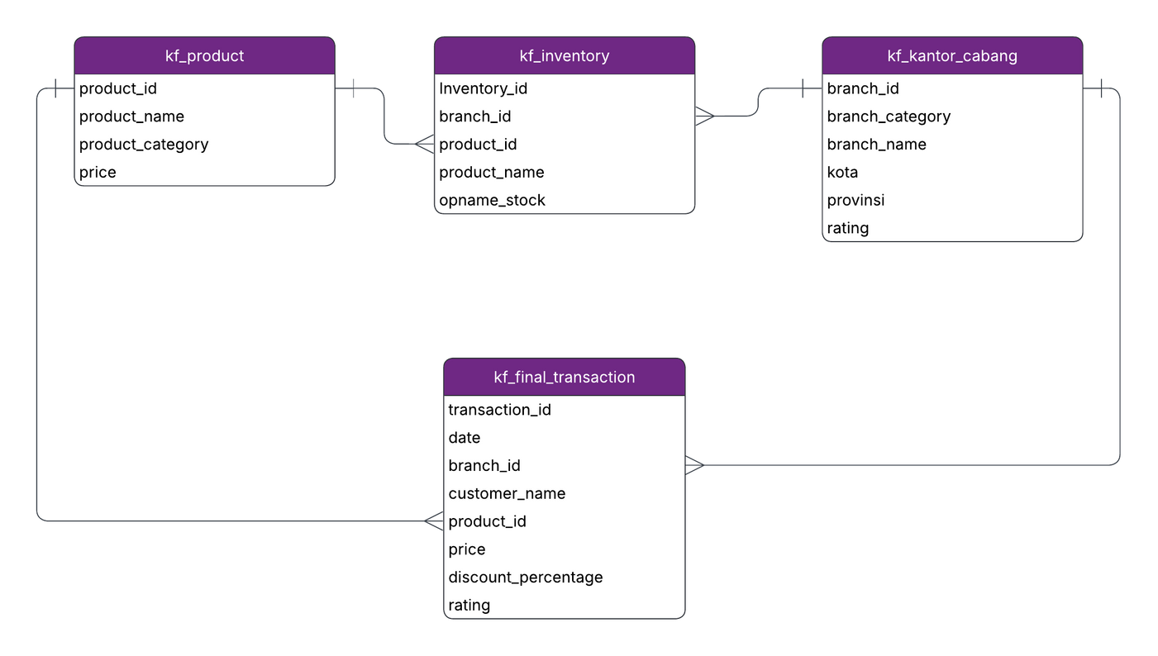




Dataset & Entity Relationship Diagram
kf_product: provides product names, categories, and corresponding base prices
kf_kantor_cabang: branch-level data including location and ratings
kf_inventory: includes stock levels per branch (excluded from analysis as it was not relevant)
kf_final_transaction: contains transactions records including price, discount, and customer ratings

Slide 8
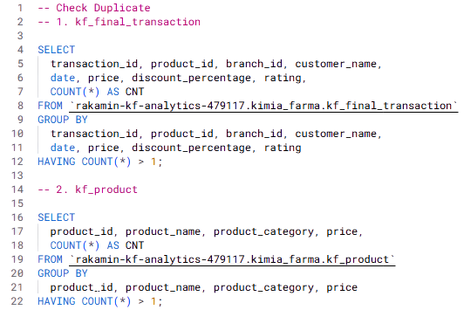
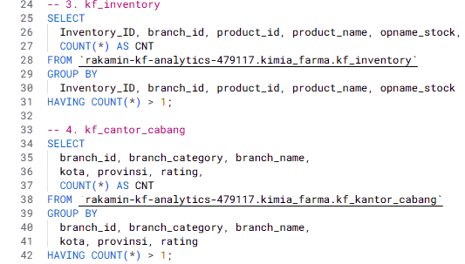
Data Sanity Check
Check for Duplicates: NO DUPLICATES
Tools: BigQuery

Slide 9
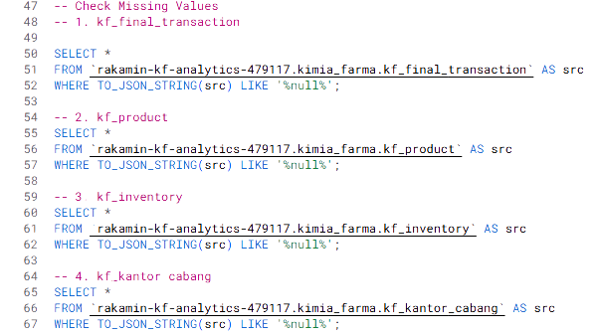
Data Sanity Check
Check for Missing Values: NO NULL
Tools: BigQuery

Slide 10
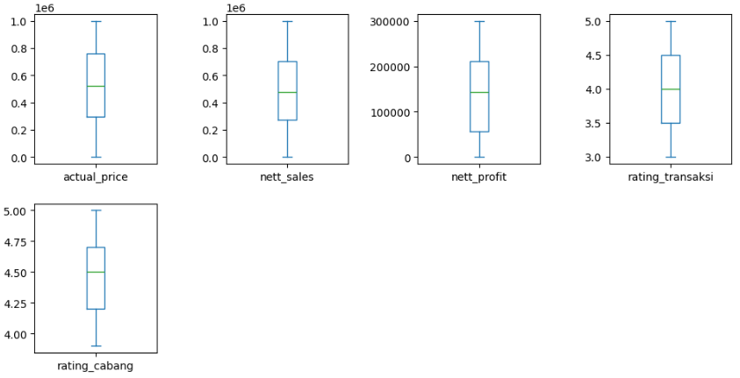
Data Sanity Check
Check for Outliers: NO OUTLIERS
Tools: Python

Slide 11
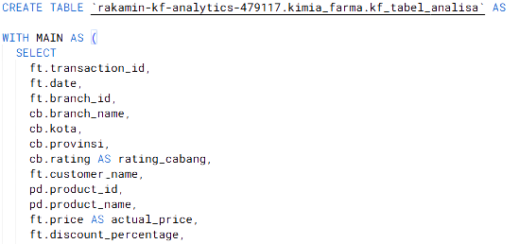
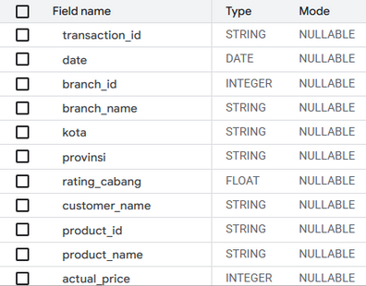
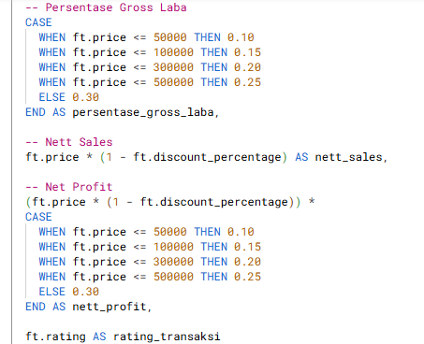
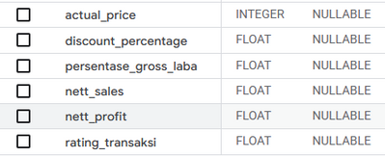
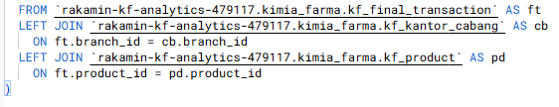
Tabel Analisa
Data Aggregation and Joining
The gross profit percentage was calculated according to the price-based guidelines provided in the brief. This step creates a new table (kf_table_analisa) in BigQuery after performing aggregation and joins.

Slide 12
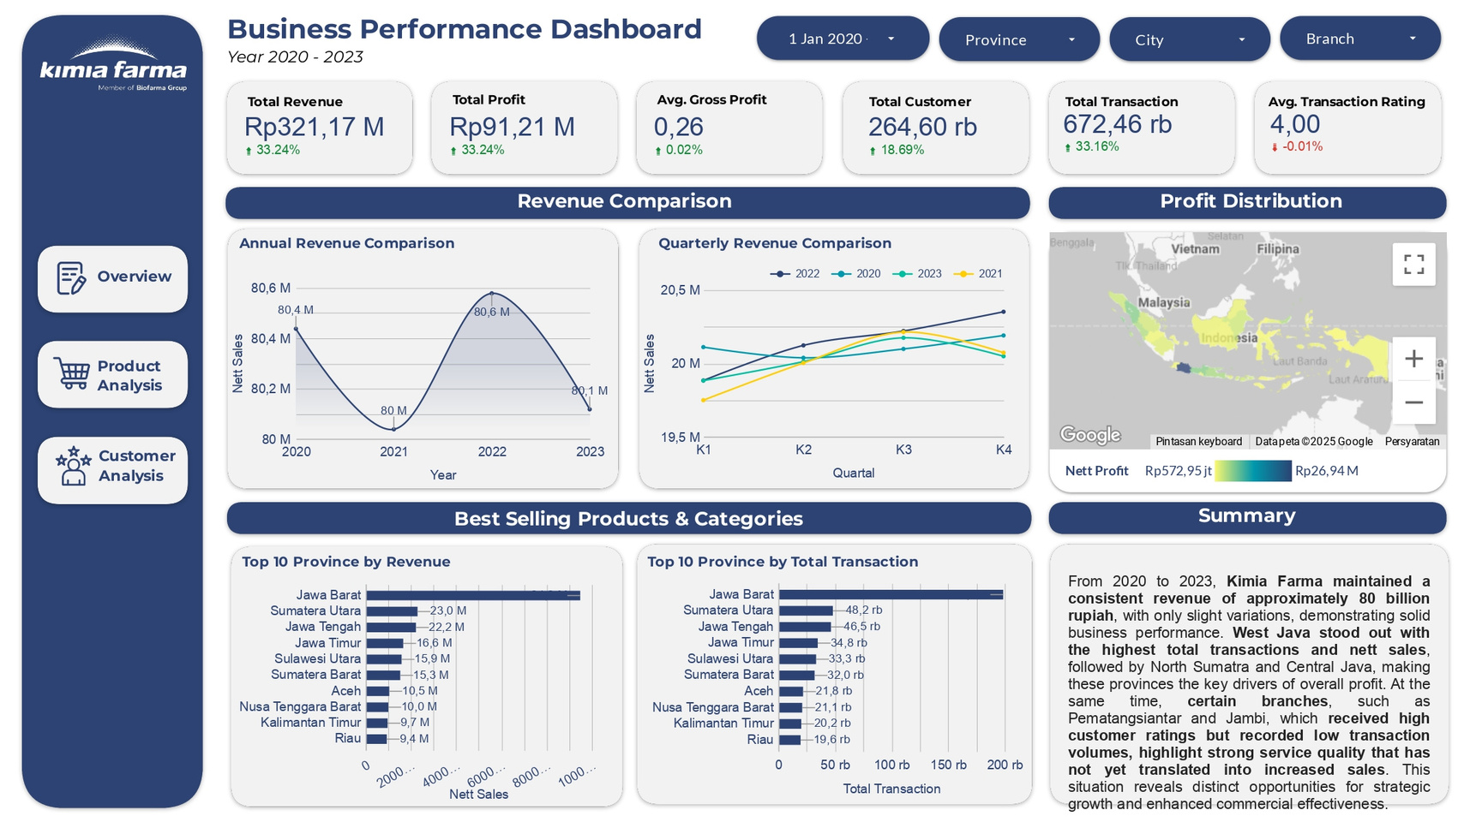
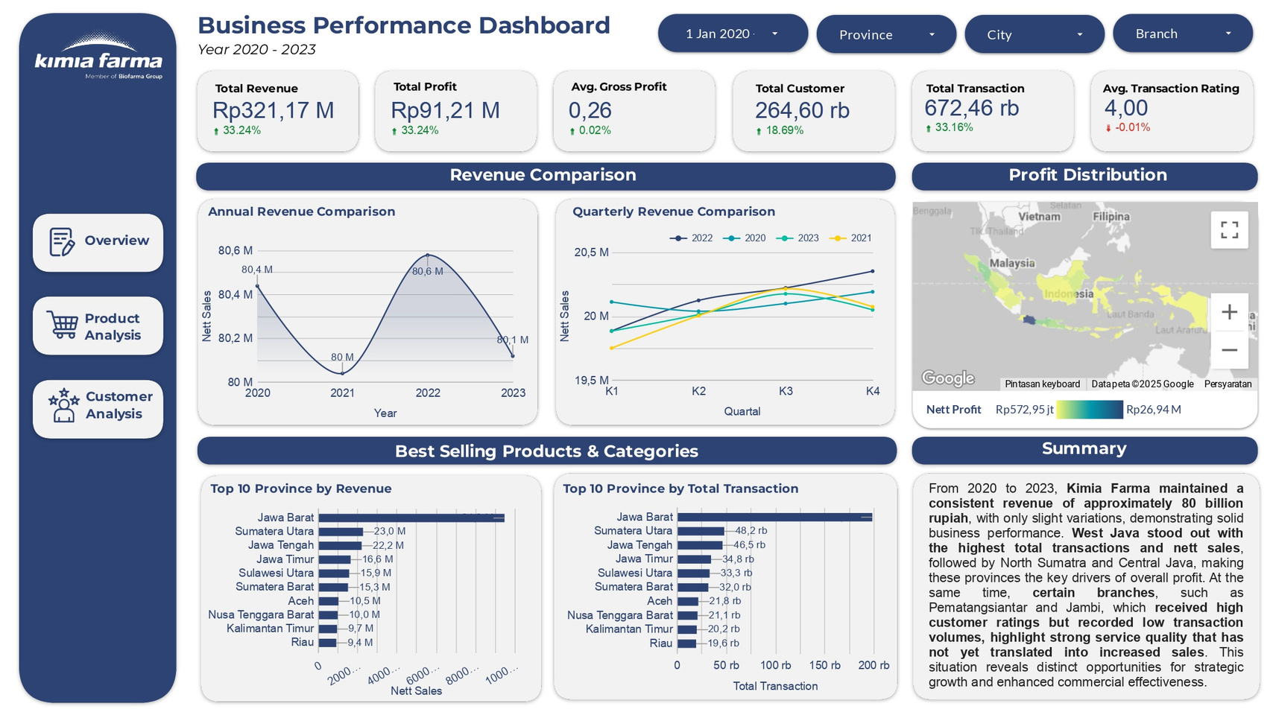
Dashboard Performance Analytics
Overview Page (1/3)

Slide 13
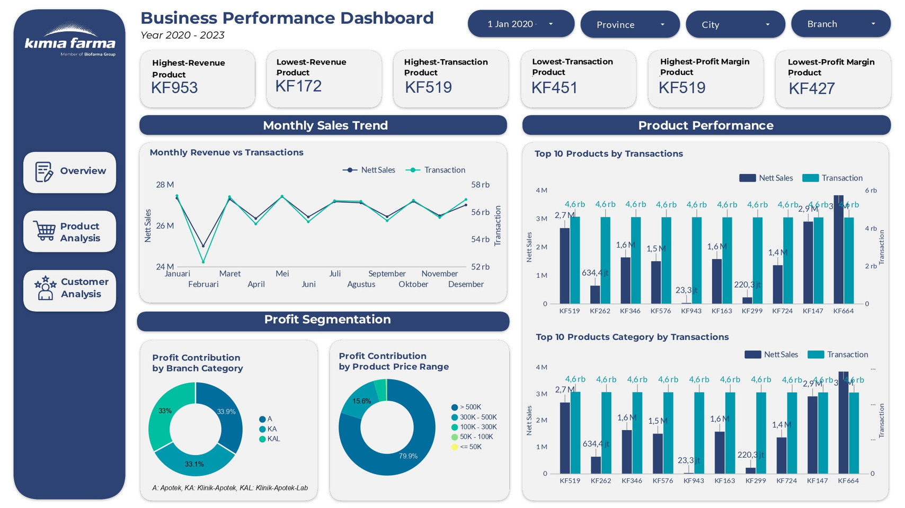
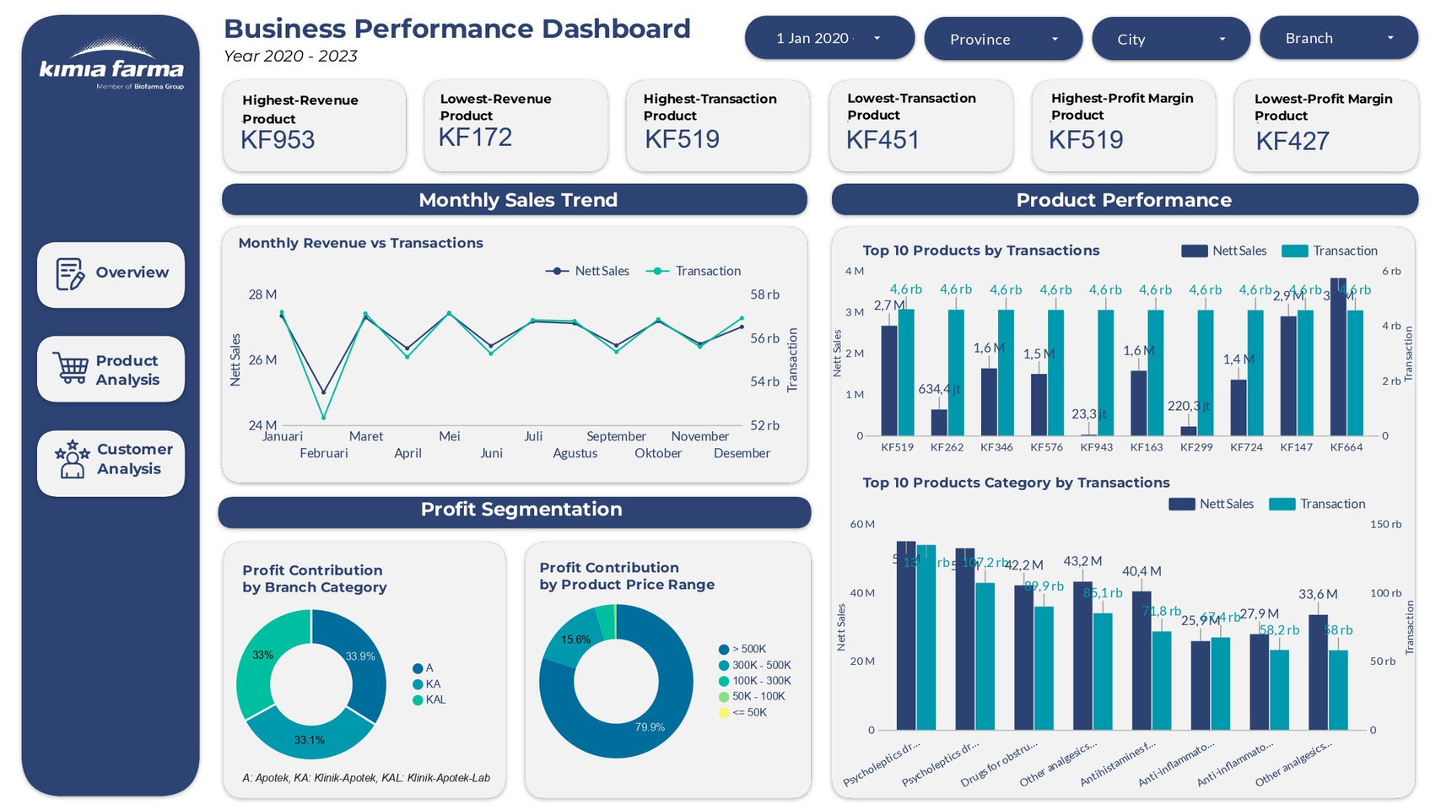
Dashboard Performance Analytics
Product Analysis Page (2/3)

Slide 14
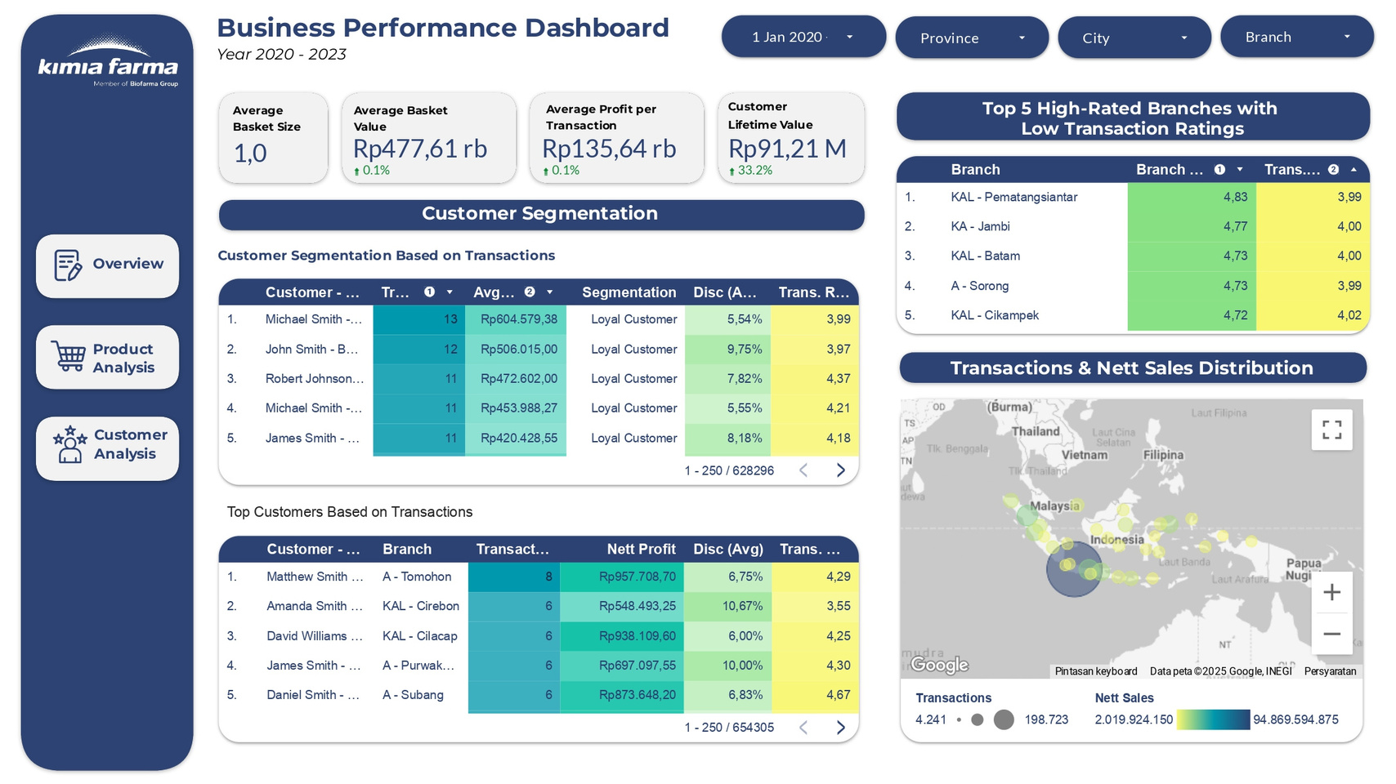
Dashboard Performance Analytics
Customer Analysis Page (3/3)

Slide 15


Macro-Meso-Micro Framework
The analysis employs a macro–meso–micro framework, starting with broad business questions and progressively narrowing down to specific data challenges. This structure is reflected in the dashboard, organized into three main sections: Overview (Macro), Product Analysis (Meso), and Customer Analysis (Micro). By moving from macro-level insights to detailed meso- and micro-level perspectives, this approach provides a comprehensive understanding of the business and effectively links strategic objectives to actionable insights.
Macro
Meso
Micro
How is Kimia Farma performing overall in its business in 2023?
How did Kimia Farma’s revenue trend evolve year over year from 2020 to 2023?
How is Kimia Farma’s profit distributed across different regions in Indonesia?
How is Kimia Farma’s business performance distributed across key provinces?
How do transaction volume and revenue move throughout the year?
How does each branch category contribute to Kimia Farma’s overall profit, and which format has the greatest potential for future profit scalability?
How is Kimia Farma’s profit distributed across different product price ranges
What products and categories primarily drive transaction volume at Kimia Farma?
What key factors drive customer loyalty and repeat purchase behavior at Kimia Farma?
How is the distribution of transactions and net sales across regions?
What factors drive high branch ratings but relatively low transaction ratings at Kimia Farma?

Slide 16
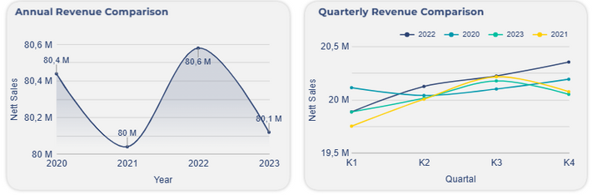
Macro Analysis - Overview
Q1: How is Kimia Farma performing overall in its business in 2023?
Q2: How did Kimia Farma’s revenue trend evolve year over year from 2020 to 2023?
Kimia Farma’s business expansion is reflected in a 33.24% revenue increase to IDR 321.17 billion and a rise in profit to IDR 91.21 billion, with a stable gross profit margin of 0.26, demonstrating the company’s ability to maintain profitability amid growth.
On a quarterly basis, Kimia Farma’s revenue exhibits a clear seasonality pattern, strengthening from Q1 to a peak in Q3 before moderating in Q4. The Q1–Q3 uptrend, which coincides with the rainy-to-dry season transition, is driven by higher disease incidence, weather shifts, and elevated economic activity that boost demand for healthcare products, while the Q4 slowdown reflects year-end consumer spending shifts, slower institutional budget realization, and post-peak demand normalization.
Kimia Farma’s revenue performance from 2020 to 2023 was heavily influenced by the COVID-19 pandemic cycle, with stability in 2020, a decline in 2021 due to mobility restrictions, supply chain disruptions, and shifts in consumer behavior toward more selective spending on non-essential items, a strong rebound in 2022 amid economic recovery, and a mild normalization in 2023. This pattern indicates that 2022 growth was largely recovery-driven, while 2023 marks a transition toward a more stable market phase
Recommendation
Recommendation
Front-load revenue acceleration in Q1–Q3 by prioritizing major promotions, product launches, and healthcare campaigns during peak demand driven by seasonal diseases and high mobility.
Optimize inventory and supply planning ahead of Q1–Q3 to prevent stockouts during demand surges and avoid excess stock accumulation entering Q4.
Shift focus in Q4 from volume growth to margin optimization, by emphasizing high-margin wellness, chronic care, and private-label products as demand normalizes.
Adjust marketing strategy in Q4 toward retention and loyalty programs, rather than aggressive acquisition, to stabilize revenue during the natural seasonal slowdown.
An 18.59% increase in the customer base, accompanied by a stronger 33.16% surge in transaction volume, indicates the company’s success in expanding its market reach while also driving higher purchase frequency. However, a slight 0.01% decline in the average transaction rating to 4.00 signals the need for continued focus on maintaining and enhancing service quality amid rapid operational expansion.
Shift from recovery-driven growth to sustainable growth by strengthening structurally stable segments such as preventive, chronic care, and wellness products with long-term recurring demand.
Enhance supply chain resilience through supplier diversification, improved demand forecasting accuracy, and strategic buffer stock to safeguard revenue stability during potential disruptions.
Accelerate digital and omnichannel expansion by strengthening e-pharmacy capabilities, loyalty ecosystems, and online–offline (O2O) integration to sustain post-normalization growth.

Slide 17
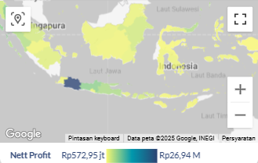
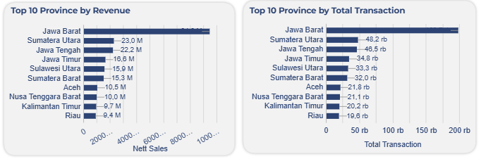
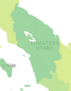
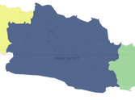

Macro Analysis - Overview
Q3: How is Kimia Farma’s profit distributed across different regions in Indonesia?
Q3: How is Kimia Farma’s profit distributed across different regions in Indonesia?
West Java
Massive population base, dense urbanization, and intense healthcare activity
The profit map shows that Kimia Farma’s profit is unevenly distributed across Indonesia and is mainly concentrated in a few core regions, particularly Java and other areas with high economic activity. The wide profit range from approximately Rp572 thousand to Rp26.94 billion highlights significant regional performance gaps, where high profit regions are supported by stronger purchasing power, higher population density, and better distribution infrastructure, while low profit regions reflect untapped market potential and access limitations.
North Sumatera & Central Java
Form a strong second tier, though their revenue contribution relative to transaction volume suggests lower average basket sizes and a heavier reliance on generic or lower margin products.
East Java
Very high transaction volume but comparatively lower revenue, indicating a volume driven market that remains under monetized and presents significant opportunity for up selling and premiumization.
N. Sulawesi, W. Sumatera, Aceh,
W. Nusa Tenggara, Riau, E. Kalimantan
Prioritize profit based expansion by focusing new outlets, capacity upgrades, and marketing investments on high profit regions to maximize return on investment.
Apply differentiated strategies for low profit regions by adopting cost efficient models such as mini outlets, delivery and e pharmacy services, and partnerships with local healthcare facilities.
Implement regional clustering based on profit performance to define clear strategies for high profit core regions, mid tier efficiency driven regions, and low profit frontier regions.
Align product mix with regional characteristics by pushing wellness, chronic care, and private label products in high profit areas while focusing on essential and generic medicines in low profit regions.
Optimize geographic inventory allocation by prioritizing fast moving and high margin products to high profit regions to accelerate cash flow and maximize profit contribution.
Contribute relatively smaller shares to total revenue, reflecting a combination of early stage market development and untapped monetization potential despite their underlying economic and industrial strengths (Riau & E. Kalimantan).
Recommendation
West Java
North Sumatera & Central Java
Expand premium outlets by introducing premium health check up and specialized pharmacy services while accelerating high margin wellness, chronic care, and private label products through an integrated omnichannel strategy.
Increase basket size through bundled chronic care therapies, subscription medicine programs, and targeted upselling from generics to branded and wellness products.

Slide 18
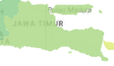
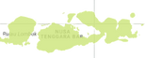
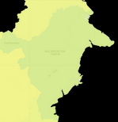
East Java
N. Sulawesi, W. Sumatera, Aceh, W. Nusa Tenggara
Monetize high transaction volume by enhancing premiumization, cross selling, and in store health services to gradually increase revenue per transaction.
Adopt a low cost, access driven model by focusing on essential medicines, digital pharmacy, delivery services, and logistics efficiency rather than heavy physical expansion.
East Kalimantan & Riau
Unlock industrial driven revenue through B2B healthcare partnerships, corporate pharmacy services, and employee health programs for the mining, oil, and manufacturing sectors.
How can Kimia Farma reduce its dependency on its core growth region by accelerating revenue growth in second tier and outer regions?
Kimia Farma can reduce its dependency on West Java by accelerating potential based expansion in second tier and outer regions through strengthening last mile distribution networks, expanding e-pharmacy and delivery services to overcome physical access limitations, and establishing strategic partnerships with local hospitals, clinics, and public health centers to enhance service accessibility, transaction volume, and long term market penetration.

Slide 19
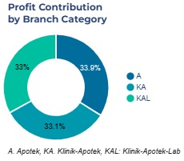
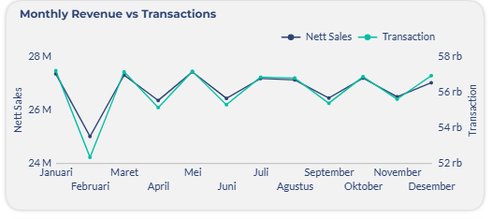
Meso Analysis - Product Analysis
Key Metrics
Q1: How do transaction volume and revenue move throughout the year?
Profit contribution across branch categories is evenly distributed, with Apotek at approximately 33.9%, Klinik-Apotek at 33.1%, and Klinik-Apotek-Lab at 33.0%, indicating that no single format currently dominates profitability and that the business portfolio is well diversified with balanced risk exposure.
However, this near-equal contribution also suggests that no format has yet been fully optimized as a primary profit accelerator, reinforcing the need to scale up the most capital-efficient format through ROI-based evaluation and replicate the best-performing model in high-potential regions to accelerate overall profit growth.
KF953
Drugs for obstructive airway diseases.
KF172
Psycholeptics drugs, specifically hypnotics and sedative drugs.
In 2023, net sales closely tracked transaction volume, indicating that revenue movements were largely volume driven rather than driven by basket size growth. Following a sharp post holiday dip in February, performance recovered from March to May, softened mid year, rebounded in October, and closed strongly in December, highlighting clear monthly seasonality and the need to shift future growth toward basket size expansion and premiumization to reduce reliance on transaction growth alone.
KF519
Analgesics and antipyretics, specifically pyrazolones and anilides.
KF451
Drugs for obstructive airway diseases.
KF427
Analgesics and antipyretics drugs, salicylic acid and derivatives.
Q2: How does each branch category contribute to Kimia Farma’s overall profit, and which format has the greatest potential for future profit scalability?
Q3: How is Kimia Farma’s profit distributed across different product price ranges

Slide 20
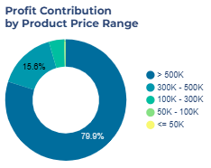
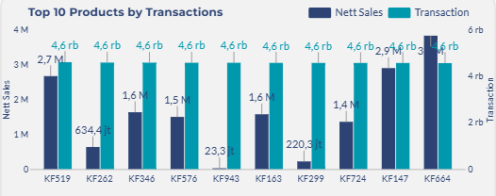
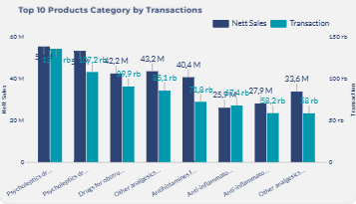
Meso Analysis - Product Analysis
Q4: What products and categories primarily drive transaction volume at Kimia Farma?
KF943
Analgesics and antipyretics, salicylic acid drugs
KF163
Non-steroidal anti-inflammatory drugs (NSAIDs), specifically the acetic acid derivatives subgroup.
KF299
Psycholeptics, hypnotics and sedatives drugs
KF724
Drugs for obstructive airway diseases
KF147
Antihistamines for systemic use
Profit is highly concentrated in the >500K price segment, which contributes approximately 79.9% of total profit, while the 300K–500K segment accounts for only 15.6% and lower price tiers contribute marginally. This structure indicates that Kimia Farma’s profitability is heavily anchored on high value products such as specialized therapies, medical devices, and premium healthcare services, whereas lower and mid priced products primarily act as traffic drivers, revealing a significant monetization gap and increasing exposure to potential purchasing power fluctuations in upper income segments.
KF664
Psycholeptics, anxiolytic drugs
Kimia Farma’s transaction volume is primarily driven by everyday pain, inflammation, allergy, sleep disorders, anxiety, and airway-related conditions, a pattern that is also reflected in the top product categories dominated by psycholeptics (hypnotics, sedatives, and anxiolytics), respiratory drugs, analgesics–antipyretics, antihistamines, and non-steroidal anti-inflammatory drugs (NSAIDs).
Despite similarly high transaction volumes across the top products, their net sales performance varies significantly, indicating a clear monetization gap within the high-traffic portfolio. Some products already function as strong revenue generators with high value per transaction, while others primarily act as traffic drivers with relatively low revenue yield, highlighting the need for targeted pricing, bundling, and product positioning strategies to improve overall revenue quality.
Strengthen and scale the premium segment through strong inventory control, superior service quality, and prioritization of high margin specialized therapies, medical devices, and premium healthcare services as the main profit driver.
>500k Segment
Upgrade the mid-tier segment through strategic product bundling, cross-selling from generics to branded and wellness products, and targeted promotions to structurally migrate demand toward higher-value transactions.
300 - 500k
Segment
KF519
Analgesics and antipyretics, pyrazolones and anilides drugs
<300k Segment
Position the entry-level segment as a customer acquisition funnel through high volume penetration, followed by gradual migration to higher value products via education, loyalty programs, and personalized recommendations.
KF262
Psycholeptics, hypnotics and sedatives drugs
KF346
Non-steroidal anti-inflammatory drugs (NSAIDs), specifically the acetic acid derivatives subgroup.
KF576
Analgesics and antipyretics, salicylic acid drugs

Slide 21
Recommendation
Prioritize high-revenue and high-margin products through improved shelf visibility, stronger stock allocation, and active pharmacist recommendations to maximize return from existing traffic, while ensuring consistent availability of stable-demand categories such as psycholeptics, NSAIDs, and respiratory drugs to sustain traffic.
Increase monetization of high-volume, low-yield products through pharmacist-guided recommendations and optimized pack sizes without compromising patient safety.
Strengthen cross-selling strategies from entry-level products to higher-value chronic care, wellness, and premium formulations to increase basket size through clinically relevant complementary offerings such as vitamins and wellness supplements.

Slide 22
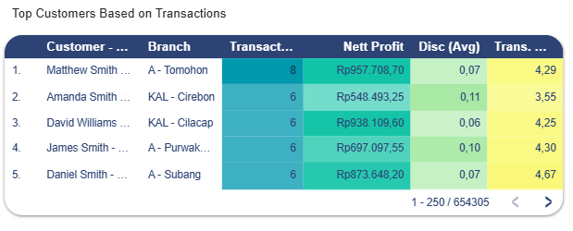
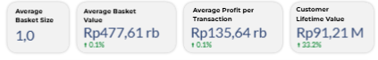
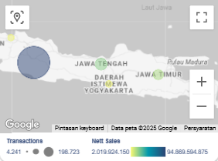
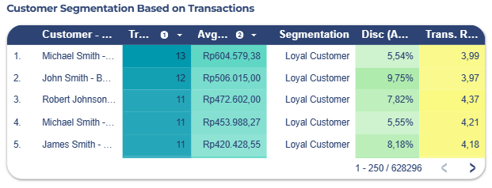
Micro Analysis - Customer Analysis
Key Metrics
Use branch-level repeat purchase and net profit metrics as performance KPIs to identify high-loyalty branches and replicate their best practices across the network.
Apply targeted, data-driven promotions instead of broad discounts, ensuring incentives support retention without eroding margin.
Enhance relationship-based selling at the outlet level through consistent customer recognition, follow-up reminders for chronic care, and proactive pharmacist engagement.
Customer behavior at Kimia Farma remains volume-driven, as reflected in an average basket size of 1.0 indicating mostly single-item purchases per visit. While average basket value (Rp477.61 thousand) and profit per transaction (Rp135.64 thousand) remain stable with slight growth, the sharp 33.2% increase in customer lifetime value to Rp91.21 million signals significantly stronger long-term customer value, highlighting clear upside potential through basket size expansion and cross-selling strategies.
The customer segmentation and top customers by transactions show that loyal customers dominate both the highest transaction frequency and profit contribution across multiple branches. Customers with repeated transactions consistently generate strong net profit even with relatively controlled average discounts, indicating that loyalty is driven more by repeat behavior and perceived value than by aggressive discount dependency.
The presence of these customers across different branches further highlights the critical role of store experience, service quality, and local relationship management in sustaining loyalty, rather than pricing incentives alone. In essence, Kimia Farma’s top profit contributors are not one-time buyers, but customers with stable engagement and consistent repeat purchasing patterns.
Q2: How is the distribution of transactions and net sales across regions?
Q1: What key factors drive customer loyalty and repeat purchase behavior at Kimia Farma?
Recommendation
Shift loyalty strategy from discount-driven to experience-driven by standardizing pharmacist service quality, consultation depth, and speed of service across branches to sustain repeat behavior.
Strengthen personalized loyalty programs based on transaction frequency and purchase history, not only spending value, to reward true repeat customers and deepen engagement.
The geographic distribution of transactions and net sales indicates a clear concentration of customer activity and revenue within core urban regions, particularly across major provinces in Java. Areas with the largest transaction bubbles do not always correspond proportionally to the highest net sales intensities, signaling a structural difference between volume-driven regions and value-driven regions.

Slide 23
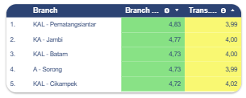
Micro Analysis - Customer Analysis
This suggests that in several high-traffic areas, customer behavior is characterized by frequent but lower-value purchases, while other regions, despite lower transaction volume, contribute disproportionately higher net sales through stronger basket value. This imbalance reflects differences in purchasing power, product mix adoption, and service utilization across regions, implying that customer value is shaped not only by how often customers buy, but also by what they buy and how they are served.
The consistently high Branch Ratings (around 4.75) reflect strong customer perceptions of the physical environment and human interaction, including branch cleanliness, location, staff friendliness, product knowledge, and overall atmosphere. In contrast, the lower Transaction Ratings (around 4.00) signal friction within the service delivery process itself, such as prolonged waiting times, workflow inefficiencies, digital or self-service limitations, and procedural or system-related bottlenecks. This gap highlights a clear misalignment between strong service experience and operational execution, which constrains the branch’s ability to convert service excellence into stronger transactional performance.
Recommendation
High-transaction but lower-value regions should focus on basket size expansion through clinically guided cross-selling, premium service offerings, and chronic care programs.
High-revenue but lower-transaction regions should prioritize traffic stimulation through accessibility, digital ordering, and convenience-driven services.
Regional customer lifetime value and revenue-per-transaction metrics should be embedded as core KPIs to avoid over-reliance on transaction volume alone.
Recommendation
Streamline transaction workflows by reducing unnecessary steps, simplifying procedures, and standardizing service processes to shorten waiting times.
Strengthen digital and self-service channel reliability to minimize system delays, input errors, and transaction bottlenecks.
Implement real-time queue monitoring and staff reallocation during peak hours to balance service load and improve transaction speed.
Equip frontliners and pharmacists with soft-selling and service-to-conversion training to translate strong service perception into higher transaction value without compromising trust.
Track transaction efficiency KPIs at branch level (waiting time, transaction completion time, transaction per visit) alongside service ratings to ensure service excellence is supported by operational performance.
Q3: What factors drive high branch ratings but relatively low transaction ratings at Kimia Farma?

Slide 24


Thank You!
Github
Youtube
Google Looker Studio

